Slide 1
Instructions to teachers
Please feel free to modify the presentation as needed.
A few additional explanations are available below the slides.
Please note that some slides have animations.
Test the video link on slide 11 before the presentation!

Slide 2
Suggested Lesson Structure
Introduction (5 min)
Thoughts and emotions about climate change.
Presentation (10-15 min)
Zoom out to grasp the bigger picture:
- What is climate change all about?
- What do people disagree about?
Play Climate Call (30 min)
- Introduce the cards and the rules of the game.
- Play in groups of 4-6 students.
- Discuss and reflect together.
Optional add-ons / extensions for deeper understanding
The Carbon Cycle - how does it work?(10 min)
Sustainable Lifestyles (10-20 min)

Slide 3
Cracking the climate code
with Climate Call
AN INTRODUCTION TO THE GAME AND CLIMATE CHANGE

Slide 4
What do you feel when you think about climate change?
Fear
Guilt
Anxiety
Hope
Worry/concern
Motivation/activism
Indifference/apathetic
Dedication
Anger/frustration
Sadness
Stress
No feelings
Notes:
Tip: Create a Mentimeter poll with this question. For mature groups, you can begin with an open-ended query: 'What thoughts and emotions do you have about climate change?' and gather responses as a word cloud.
Climate anxiety or climate distress are recognized terms for strong negative emotions related to climate change, including worry about personal and collective safety, panic attacks, depression, loss of appetite, and guilt for actions that harm the climate. Shame and guilt may also arise when discussing climate issues. Some may express indifference, saying, 'It doesn't matter what we do.'
While it may be tempting to avoid sensitive topics, especially with young people, this can lead to the perception that adults can't discuss these issues, which is often worse. Instead, encourage open discussions, listen to students, and respond with empathy. Make sure they feel heard and supported.

Slide 5
What do we mean when we talk about "climate issue"?
the big picture

Slide 6

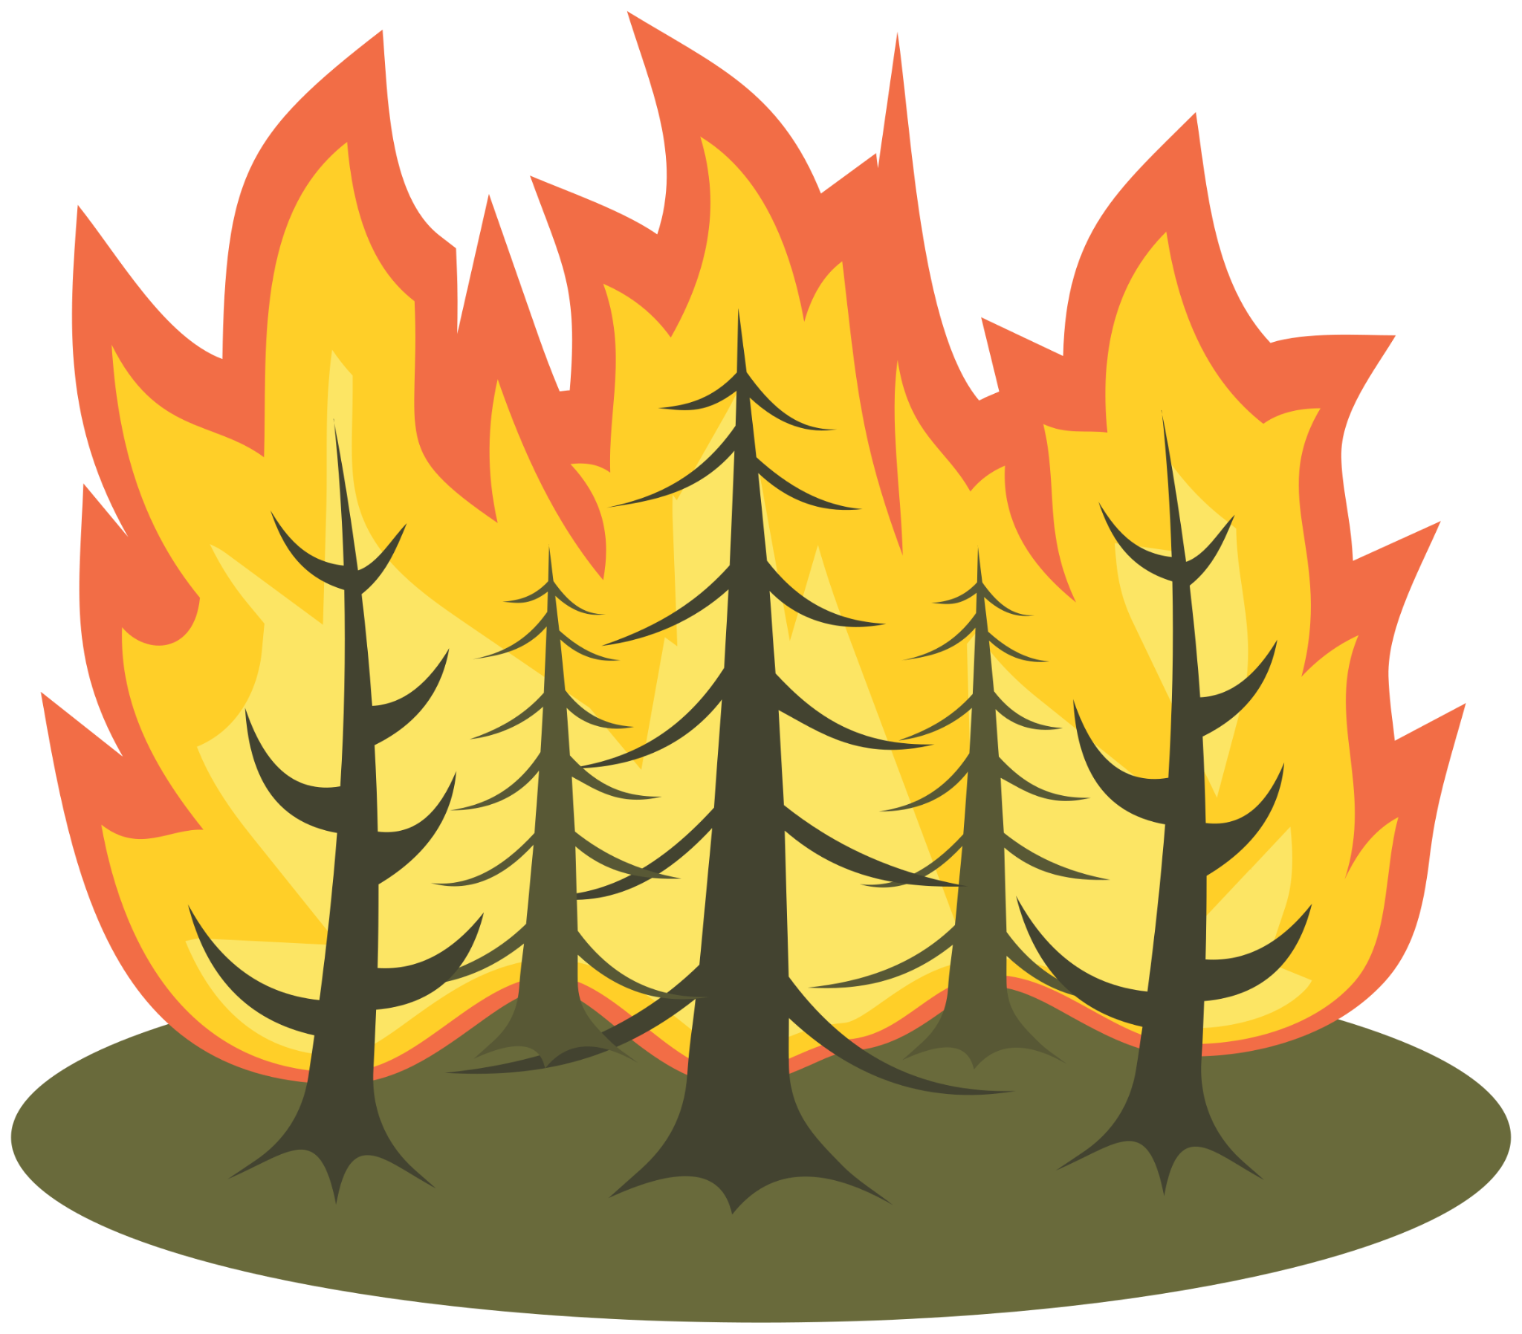
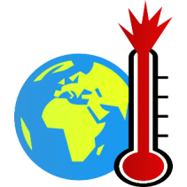
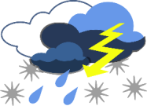





The climate challenge
Societal demand of fossil fuels, food etc drives emissions of greenhouse gases
Higher temperature, rising sea level, melting ice, changes in rain patterns etc
Flooding, droughts, disruption to food production systems, loss of biodiversity etc
Causes
Climate change
(observed changes)
Consequences
Fysikaliska Samhälleliga
Lokala Globala
Physical Societal
Local Global
Lifestyle changes, policy measures, technological innovation
Actions
Individual Collective
Notes:
Climate change is driven by greenhouse gas emissions, mainly from fossil fuels (causes). These emissions have significantly increased, raising greenhouse gas concentrations in the atmosphere. This intensifies the natural greenhouse effect, leading to global warming. Observed climate changes include a 0.8-1.0°C temperature rise, rising sea levels, more heatwaves, altered rainfall patterns, and glacial retreat.
Consequences of these changes include droughts, floods, coastal erosion, biodiversity loss, and disruptions to agriculture. Vulnerable populations are hit hardest.
To combat this, we need a multifaceted approach which includes:
Lifestyle Changes: Individuals can reduce their carbon footprint by adopting eco-friendly habits, like plant-based diets and reduced consumption.
Policy Measures: Governments must enforce emissions limits and carbon pricing, providing incentives and imposing bans on high-emission activities.
Technological Innovation: Transitioning to low-carbon technologies across sectors is vital.
These actions aim to limit global warming to 2°C or lower, aligning with the Paris Agreement's goals.

Slide 7
...but people have different opinions/thoughts/beliefs
Why is
the climate changing?
How are humans and nature affected?
Causes
Climate change
Consequences
Fysikaliska Samhälleliga
Lokala Globala
Physical Societal
Local Global
What can be done? What should be done?
Actions
Individual Collective

Slide 8

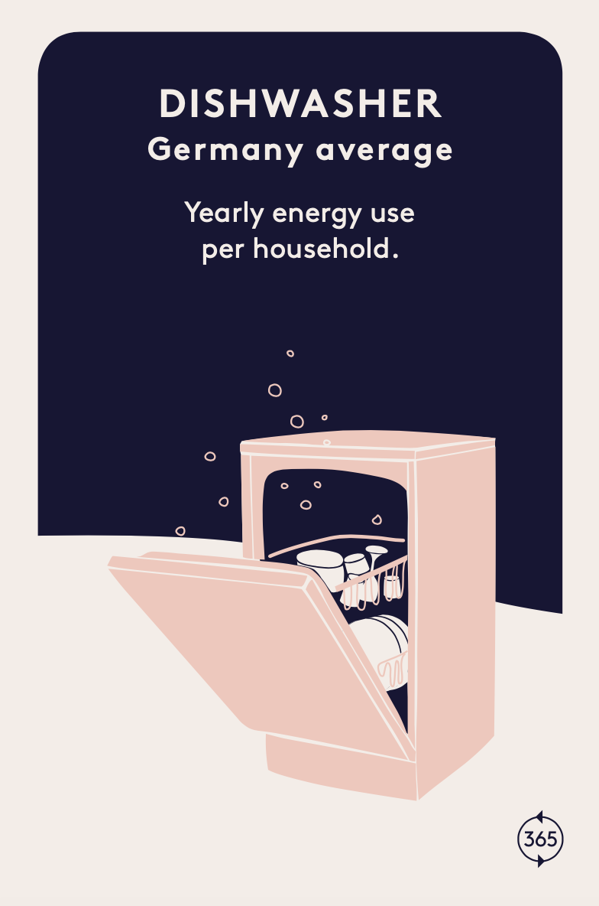
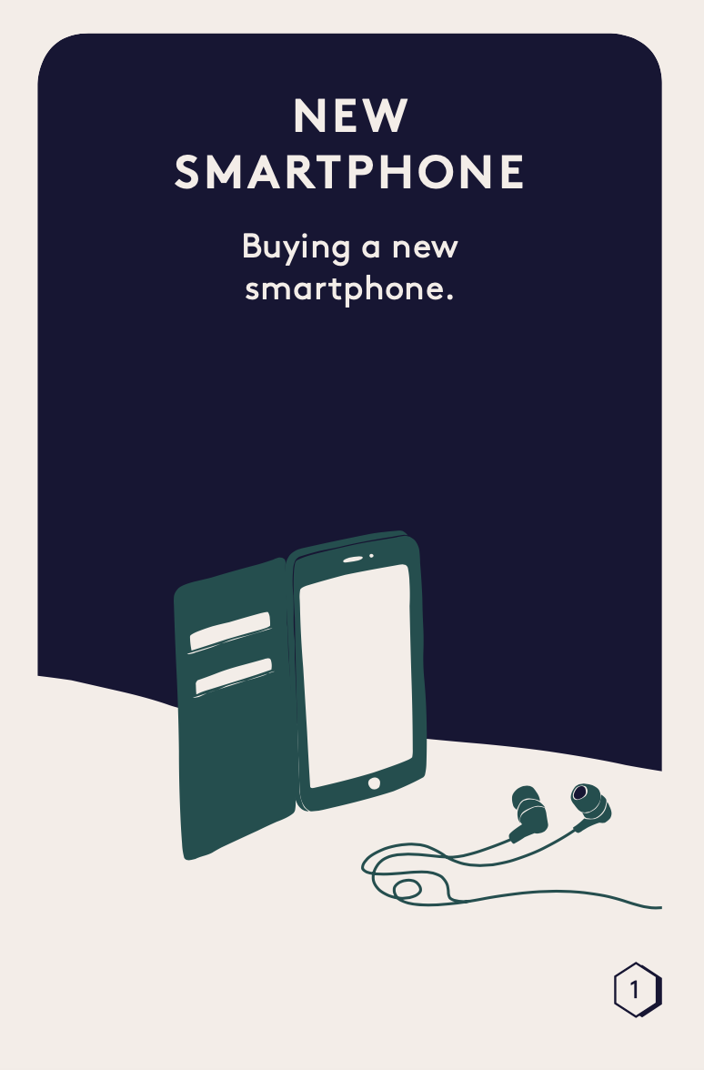
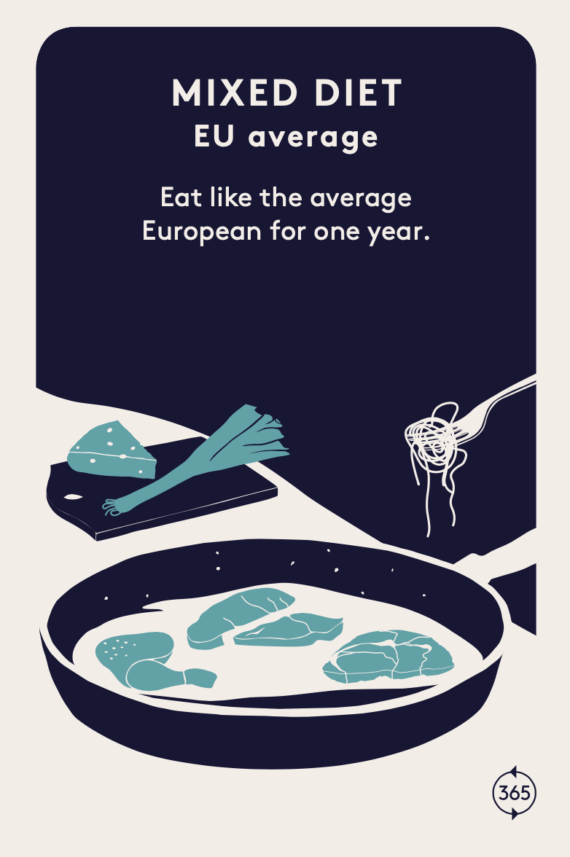
Climate Call

Slide 9
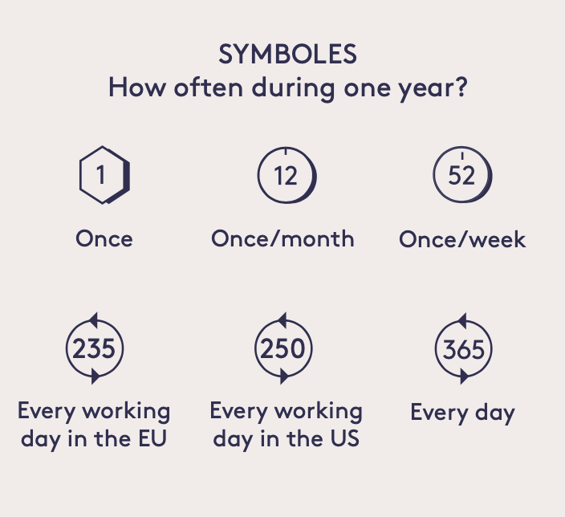
What do you think has the biggest climate impact?

Slide 10
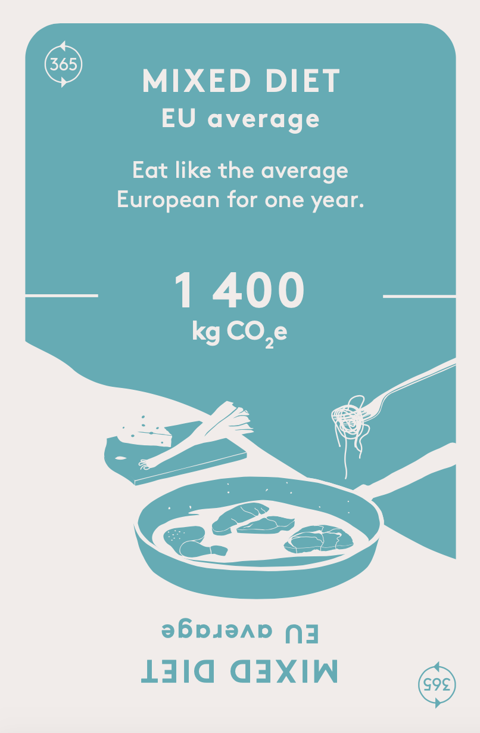
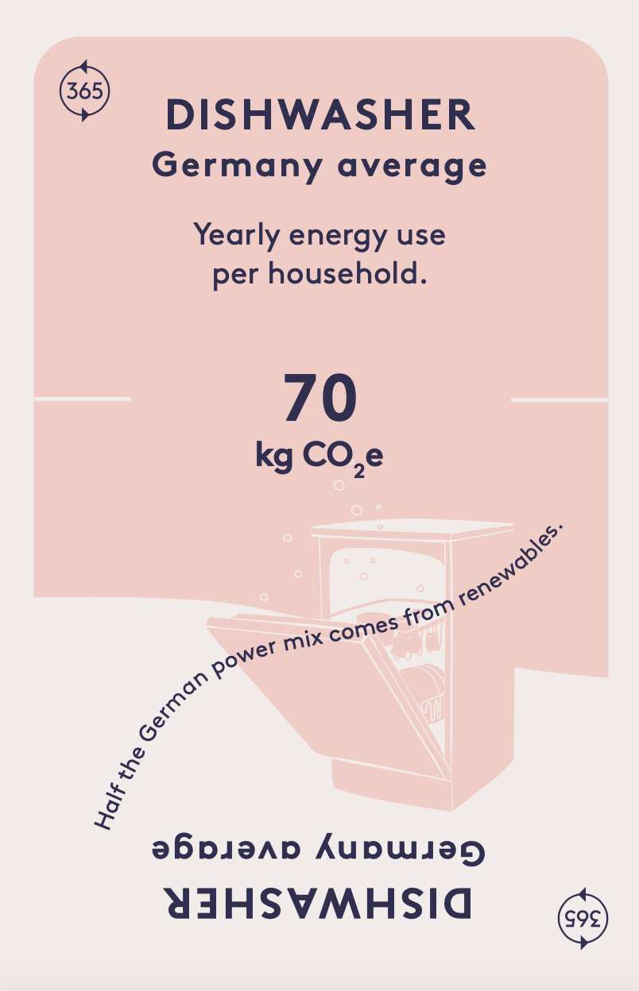
Category colours
Turquoise = Food
Yellow = Travel
Pink = Accommodation
Dark Green = Other
CO₂e
CO₂e stand for greenhouse gas equivalents which is a measure of emissions of greenhouse gases that contribute to global warming (carbon dioxide, methane, nitrous oxide, and fluorinated gases).

Slide 11
How is Climate Call played?
Watch the instruction video here!

Slide 12
Play in groups of 4-6 people.
Each group forms two teams.
During the game:
- Argue for where the cards are placed.
- Discuss why it was correct/incorrect.
Notes:
Tips:
- Add an extra rule that the team must provide an explanation for the emissions of the activity BEFORE they place the card. This may slow down the game but enhances learning about what influences the size of carbon emissions.
- Rotate teams after they've played 1-2 rounds to encourage new discussions.
- Play in teams of 3 people in each team to foster broader discussions or with 2 people in each team to increase the pace of the game.

Slide 13
After the game: Reflect together in the class
What surprised you the most during the game, and why?
In the various categories of food, travel, and accommodation, what has the most significant impact on emissions?
Which activities contribute most to your emissions, and how do you think you could reduce them?
What actions can various stakeholders like individuals, politicians, companies, organizations, associations, schools, and municipalities take to decrease greenhouse gas emissions?

Slide 14
OPTIONAL ADD-ONS
Optional add-ons / extensions for continued learning
The Carbon Cycle - how does it work?
Sustainable Lifestyles

Slide 15
What is the problem with emitting carbon dioxide?
The carbon cycle
(a crash course!)

Slide 16




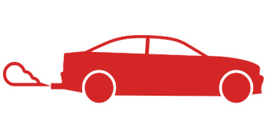
Our emissions disrupt the balance in the system!
atmosphere
biosphere
ocean
Notes:
In the so-called active carbon cycle, carbon flows between the atmosphere, biosphere, and oceans. The amount of carbon in these three components used to be in a kind of equilibrium. However, this balance has been disrupted due to carbon dioxide emissions.
Some of the carbon dioxide is gradually absorbed by the oceans and plants. This leads to an increased quantity of carbon in all parts of the carbon cycle. In 50 years, half of the carbon dioxide released today will still remain in the atmosphere. In 1,000 years, a quarter will still be present, affecting the climate by intensifying the greenhouse effect. Therefore, it's not enough to reduce emissions; they must reach net-zero levels if we want to limit global warming.

Slide 17
Avoid common misconceptions!
The reality is:
- CO2 doesn't escape into space!
- CO2 doesn't break down or decay!
- CO2 isn't captured by technology on a large scale (yet)!
atmosphere
biosphere
ocean
Notes:
Common misconceptions include the idea that the carbon dioxide released disappears into space, breaks down, or disintegrates, but that's not accurate. What actually occurs is that a portion of the carbon dioxide is gradually absorbed by the oceans and plants.

Slide 18
UN:s definition:
A way of living that helps protect the environment while improving the quality of life for everyone, with a focus on using fewer resources and creating less pollution.
What is a sustainable lifestyle?
Sustainable
Lifestyles

Slide 19
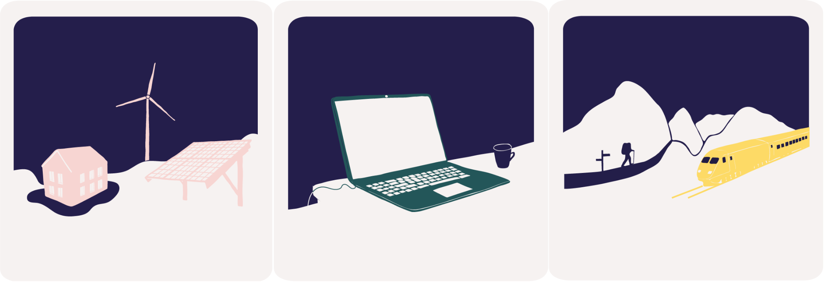

Sustainable Lifestyles
Community engagement
Work & Education
Leisure time
Eating
Living
Traveling
Shopping
Notes:
Use this slide to discuss different aspects of Sustainable Lifestyles.

Slide 20
Sustainable Consumption
Eating
Living
Traveling
Shopping
Notes:
Use this slide to discuss different aspects of Sustainable Consumption.

Slide 21
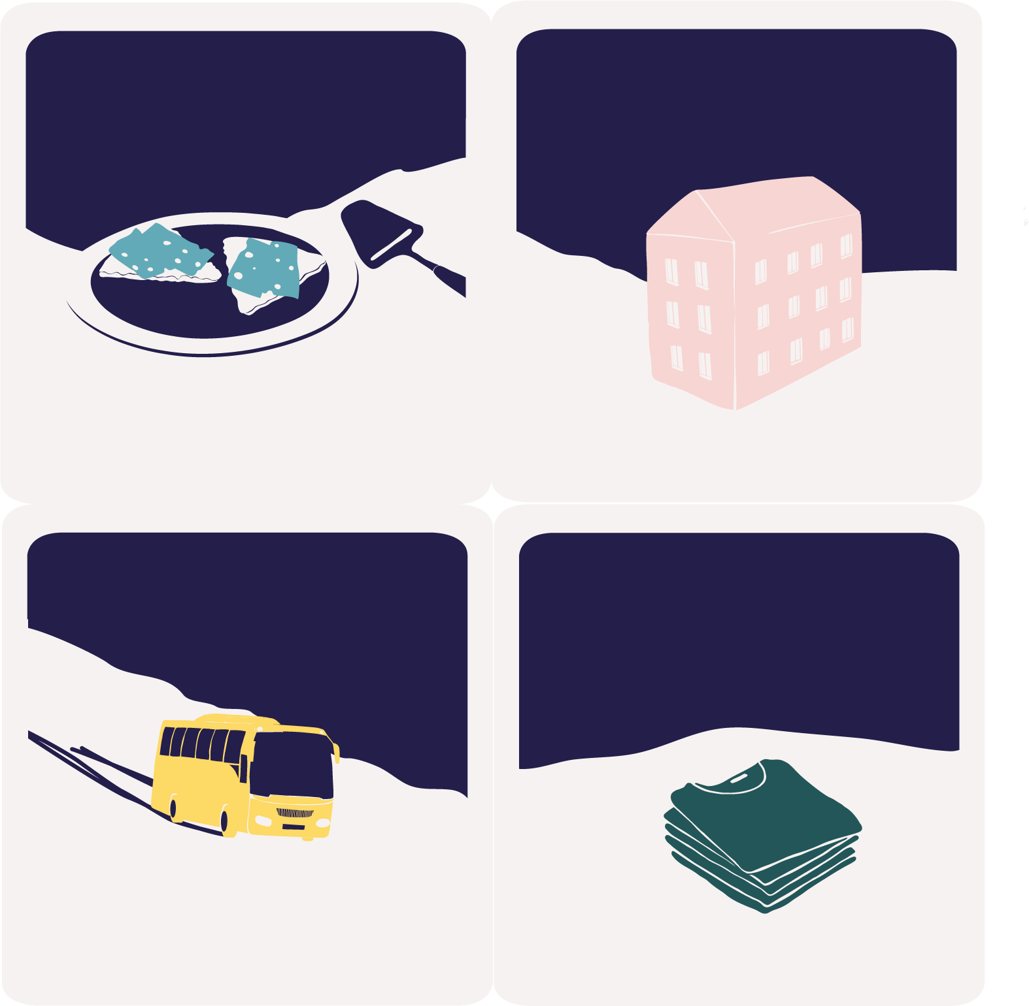
Reflect in groups
Think of one thing you could do in each category (eating, traveling, living, shopping) to consume more sustainably.
Try to be as specific as possible, for example, "ride your bike to the sport practice instead of have someone drive you in a car" rather than "travel sustainably."
Discuss in small groups for 5 minutes. Write down your suggestions, and share them with the whole group when you're done.
Eating
Living
Traveling
Shopping

Slide 22
Our tips for a more sustainable lifestyle
Living
Traveling
Shopping
Eating

